Slide 1
Regression Testing
SE401: Software Quality Assurance and Testing

Slide 2
Outline
Software Evolution
Regression Testing
Basic Problems of Regression Testing
Selecting and Prioritizing Regression Test Cases
Summary

Slide 3
Software Evolution
Change happens throughout the software development life cycle.
Before and after delivery
Change can happen to every aspect of software
Changes can affect unchanged areas
break code, introduce new bugs
uncover previous unknown bugs
reintroduce old bugs

Slide 4
Regression Test
Testing of a previously tested program following modification to ensure that new defects have not been introduced or uncovered in unchanged areas of the software, as a result of the changes made.
It should be performed whenever the software or its environment is changed.
It applies to testing at all levels.

Slide 5
Regression Testing
It is a type of software testing that intends to ensure that changes (enhancements or defect fixes) to the software have not adversely affected it.
Rerunning of tests can be on both functional and non-functional tests.
It is a type of change-related testing to detect whether defects have been introduced or uncovered in unchanged areas of the software.

Slide 6
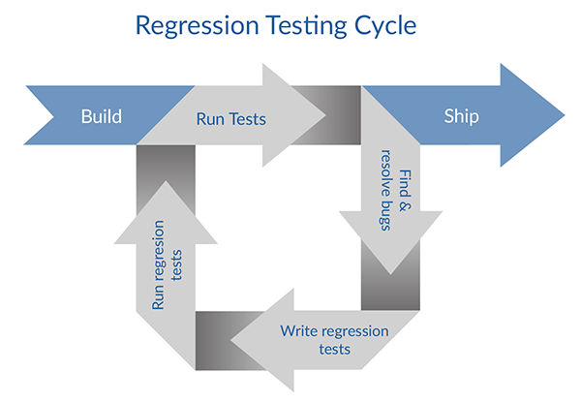
Regression Test
Keep a test suite
Use the test suite after every change
Compare output with previous tests
Understand all changes
If new tests are needed, add to the test suite.

Slide 7
Regression Testing?
 | System | Acceptance | Regression
Test for ... | Correctness, completion | Usefulness, satisfaction | Accidental changes
Test by ... | Development test group | Test group with users | Development test group
 | Verification | Validation | Verification

Slide 8
Regression Test
Yesterday it worked, today it doesn’t
I was fixing X, and accidentally broke Y
That bug was fixed, but now it’s back
Tests must be re-run after any change
Adding new features
Changing, adapting software to new conditions
Fixing other bugs
Regression testing can be a major cost of software maintenance

Slide 9
Reasons
Regression testing is conducted to make sure that fixing one thing has not broken another thing.
The need for Regression Testing could arise due to any of the changes below:
Defect fix
New feature
Change in an existing feature
Code refactoring
Change in technical design / architecture
Change in configuration / environment (hardware, software, network)

Slide 10
Basic Problems of Regression Test
Maintaining test suite
If I change feature X, how many test cases must be revised because they use feature X?
Which test cases should be removed or replaced? Which test cases should be added?
Cost of re-testing
Often proportional to product size, not change size
Big problem if testing requires manual effort

Slide 11
Test Case Maintenance
Some maintenance is inevitable
If feature X has changed, test cases for feature X will require updating
Some maintenance should be avoided
Example: Trivial changes to user interface or file format should not invalidate large numbers of test cases
Test suites should be modular!
Avoid unnecessary dependence
Generating concrete test cases from test case specifications can help

Slide 12
Obsolete and Redundant
Obsolete: A test case that is not longer valid
Tests features that have been modified, substituted, or removed
Should be removed from the test suite
Redundant: A test case that does not differ significantly from others
Unlikely to find a fault missed by similar test cases
Has some cost in re-execution
Has some (maybe more) cost in human effort to maintain
May or may not be removed, depending on costs

Slide 13
Selecting and Prioritizing Regression Test Cases
Should we re-run the whole regression test suite? If so, in what order?
Maybe you don’t care. If you can re-rerun everything automatically over lunch break, do it.
Sometimes you do care ...
Selection matters when
Test cases are expensive to execute
Prioritization matters when
A very large test suite cannot be executed every day

Slide 14
Code-Based Regression Test Selection
Observation: A test case can’t find a fault in code it doesn’t execute
In a large system, many parts of the code are untouched by many test cases
So: Only execute test cases that execute changed or new code
Notes:
Note: Code-based regression test case selection tends to be helpful for large software systems with many independent features (e.g., Eclipse with its plugins, Microsoft Word with its many tools). Almost every test case executes the core parts of the application, so if the application core is changed, code-based regression test selection will degenerate into “retest all”.
14

Slide 15
Specification-Based Regression Test Selection
Like code-based regression test case selection
Pick test cases that test new and changed functionality
Difference: No guarantee of independence
A test case that isn’t “for” changed or added feature X might find a bug in feature X anyway
Typical approach: Specification-based prioritization
Execute all test cases, but start with those that related to changed and added features

Slide 16
Prioritized Rotating Selection
Basic idea:
Execute all test cases, eventually
Execute some sooner than others
Possible priority schemes:
Round Robin:
Priority to least-recently-run test cases
Track record:
Priority to test cases that have detected faults before
Structural:
Priority for executing elements that have not been recently executed

Slide 17
Summary
Regression testing repeated after each change
After initial delivery, as software evolves
Reasons for regression testing
Basic Problems of Regression Testing
Selecting and Prioritizing Regression Test Cases
Notes:
17

